Slide 1
Problem Statement
To find the patterns of various attributes that can lead to Heart disease based on Age and Gender
Source of Data
Kaggle Platform (https://www.kaggle.com/ronitf/heart-disease-uci)

Slide 2
Executive Summary
--> This report helps us to identify the following outcomes
Gender wise variation of Fasting Blood Sugar (>120 mg/dl)
Gender wise variation of Resting Blood Pressure
Gender wise variation of Avg. Heart Rate
Age wise distribution of Cholesterol levels
Age wise distribution of Exercise Induced Angina(Exang), ST depression induced by exercise relative to rest(old peak), the slope of the peak exercise ST segment(slope)
Chest pain vs Presence of Heart Disease based on Age

Slide 3
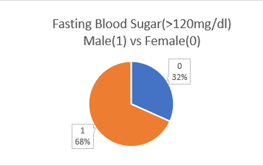
Analysis
Gender wise variation of Fasting Blood Sugar (>120 mg/dl)
The overall percentage contributes Male with 68% of fasting blood sugar and Female with 32% of fasting blood sugar.

Slide 4
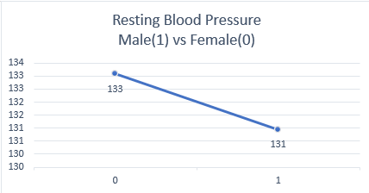
Gender wise variation of Resting Blood Pressure
The Average Resting Blood pressure is higher for female (133) when compared with male (131)

Slide 5
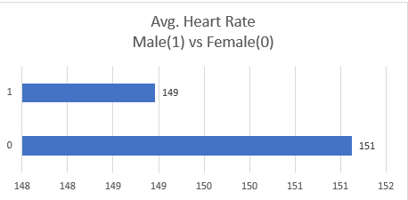
Gender wise variation of Avg. Heart Rate
The average Heart rate is also dominated by female with the value of 151 when compared with male of value 149.

Slide 6
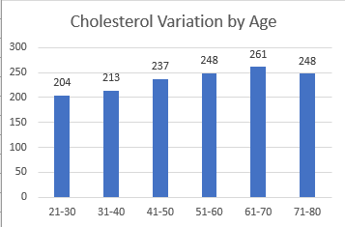
Age wise distribution of Cholesterol levels
The cholesterol levels are increasing with the age of a person and touched the peak at the age of 61-70 and then slightly decreased.

Slide 7
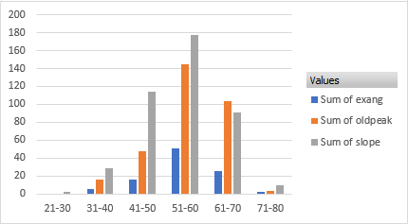
Age wise distribution of Exercise Induced Angina(Exang), ST depression induced by exercise relative to rest(old peak), the slope of the peak exercise ST segment(slope)
All these are the attributes which are used in predicting Heart disease for a person. In this values for most of the ages slope is dominating the other two factors. It is concluded that the maximal ST/HR slope can be used reliably to predict the presence or absence and the severity of coronary artery disease in individual patients with anginal pain, whether they are on beta-blocker therapy or not.

Slide 8
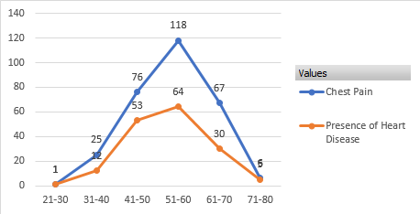
Chest pain vs Presence of Heart Disease based on Age
At the young age the presence of chest pain may lead to presence of Heart disease but reaching certain adult age the chances are less and after reaching old age the chances are more.

Slide 9
Concluding Remarks
The people with ages >40 years are more susceptible to Heart diseases since their cholesterol levels are increasing and their Exercise Induced Angina(Exang), ST depression induced by exercise relative to rest(old peak), the slope of the peak exercise ST segment(slope) are also gaining momentum in these age band.
The male are more prone to Heart disease when compared with female since their cholesterol levels, fasting blood sugar levels and chest pain cases are more.
The female should be cautious about resting blood pressure and average heart rate since this are a bit higher than male.
The presence of chest pain may not be directly related to heart disease but at the ages of 31-50 years people who suffer with chest pain are more likely to suffer with heart disease.

Slide 10
Video Link
https://youtu.be/MEyhDCnVMnk

Slide 11
Thank you

